Slide 1


The Basic Design Guidelines for Carbon Fiber Bonnet.
By :-
Rahul Phatangare
Ashish Pawle
22 December 2025

Slide 2
01 | Introduction of Bonnet ?
02 | CF Bonnet Boundary condition based on mfg. technology and package space.
03 | Bonding - CF Bonnet inner to outer
04 | Carbon Fiber Reinforcement Plies Design Rule.
05 | Corrosion Avoidance Measures for Fixings / Metal Reinforcements in CF Bonnets.
06 | What are the advantages of CF Bonnet.

Slide 3

What is Bonnet ?
The Bonnet or Bonnet is the hinged cover over the engine of motor vehicles. Bonnets can open to allow access to the engine compartment, or trunk on rear-engine and some mid-engine vehicles, for maintenance and repair.
Bonnet are typically made from the same material as the rest of the body work. This may include steel, aluminum, fiberglass or carbon fiber. However, some aftermarket companies produce replacements for steel Bonnets in fiberglass or carbon fiber to make the vehicle lighter.
Bonnet consists of an outer panel and an inner panel. The inner panel provides strength and support, where the outer panel is a metal cover which have styling factors.

Slide 4
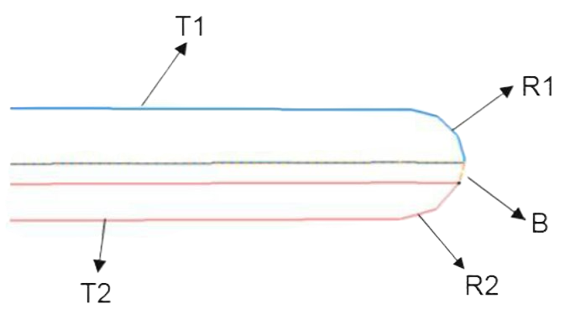
Bonnet Boundary condition based on manufacturing technology and package space :-
Design Rule Visual 01 :-
Bonnet Outer panel
T1 – Bonnet outer thickness , Range 1.3mm to 1.6mm (Depend on CAE result)
T2 – Bonnet Inner thickness , 0.9mm (Depend on CAE result)
R1 - Driven by style surface
R2 - Bonnet Inner Radius , Range 1mm to 1.5mm
B - Bond Gap , Range 0.8mm to 1mm
Bonnet Inner panel

Slide 5
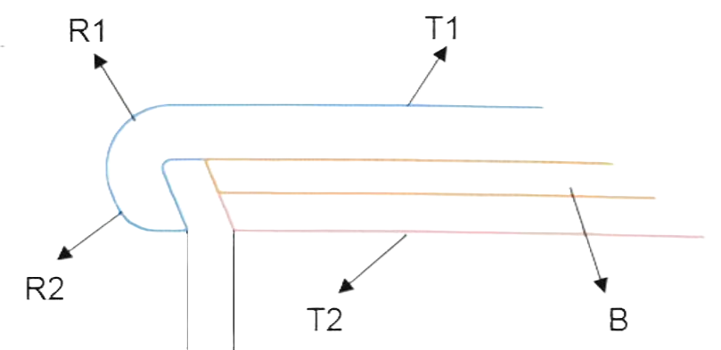
Bonnet Boundary condition based on manufacturing technology and package space :-
Design Rule Visual 02 :-
Bonnet Outer panel
T1 – Bonnet outer thickness , Range 1.3mm to 1.6mm (Depend on CAE result)
T2 – Bonnet Inner thickness , 0.9mm (Depend on CAE result)
R1 - Driven by style surface
R2 - Bonnet Inner Radius , Range 0.5mm to 1mm
B - Bond Gap , Range 0.8mm to 1mm
G - Gap , Range 1.0mm to 3mm
G
Bonnet Inner panel

Slide 6
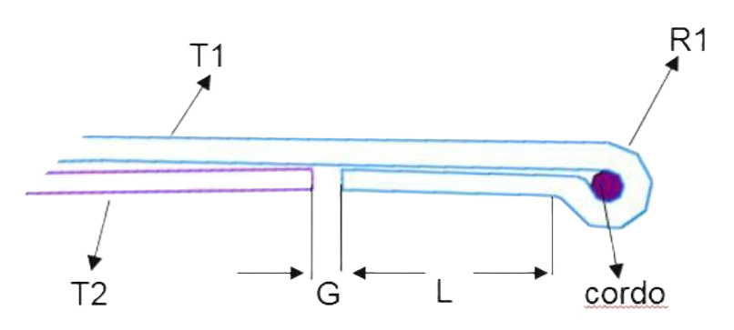
Bonnet Boundary condition based on manufacturing technology and package space :-
Design Rule Visual 03 :-
T1 – Bonnet outer thickness , Range 1.3mm to 1.6mm (Depend on CAE result)
T2 – Bonnet Inner thickness , 0.9mm (Depend on CAE result)
R1 - Driven by style surface
L - Bond Length , Range 10mm to 15mm
G - Gap , Range 1.0mm to 5mm
Bonnet Outer panel
Bonnet Inner panel

Slide 7
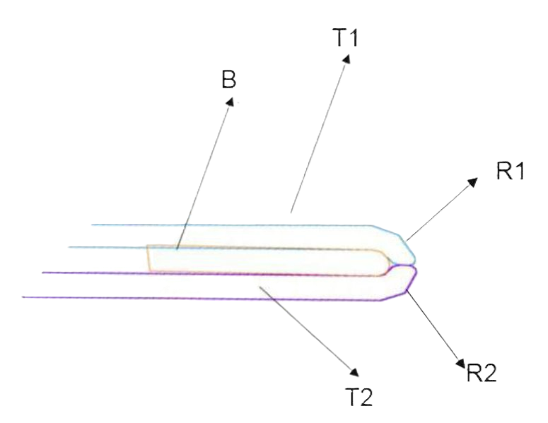
Bonnet Boundary condition based on manufacturing technology and package space :-
Design Rule Visual 04 :-
T1 – Bonnet outer thickness , Range 1.3mm to 1.6mm (Depend on CAE result)
T2 – Bonnet Inner thickness , 0.9mm (Depend on CAE result)
R1 - Driven by style surface
R2 - Bonnet Inner Radius , Range 0.5mm to 1mm
B - Bond GAP , Range 0.8MM To 1mm
Bonnet Outer panel
Bonnet Inner panel

Slide 8

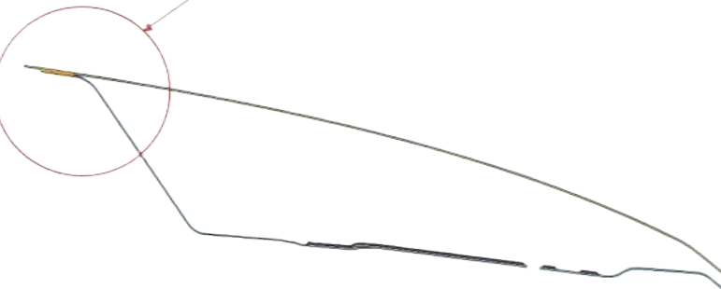
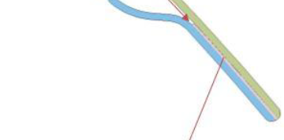
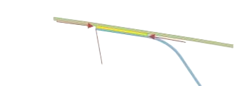


Bonding CF Bonnet inner to outer :-
Design Rule Visual 01 :-
1. Bond Flange should range from 22mm to 25mm.
2. Minimum bond flange required is 18mm (Require Supplier Confirmation)
3. Bond Gap for Carbon to Carbon Range from 0.8mm to 1.0mm
4. Bond Gap for Carbon to Metal Range from 0.5mm to 1.0mm

Slide 9
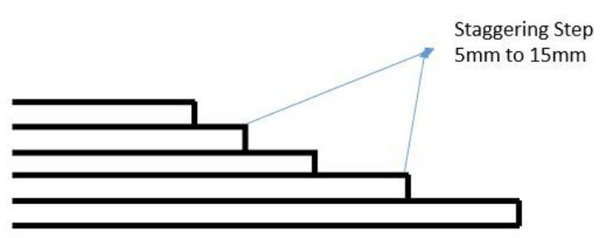
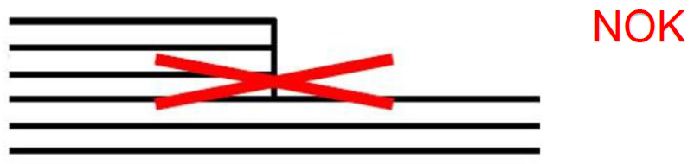
Carbon Fiber Reinforcement Plies Design Rule :-
Design Rule Visual 01 :-
1. Abrupt thickness variations must be avoided on visible areas because of the risk of witnessing on the A surface
of the component.
2. Visible A-Surface (exposed carbon or painted) should not have any patches of reinforcement plies.
3. Reinforcement plies are added to hinge and latch zones to accommodate the overall lower thickness of Bonnet inner.
4. The boundary of reinforcement plies to be finalized after CAE analysis.
5. Plies drop offs should be staggered by 5mm to 15mm ply, but it depends on geometry and the Manufacturing Process as shown in

Slide 10
Corrosion Avoidance Measures for Fixings / Metal Reinforcements in CF Bonnets :-
Design Rule Visual 01 :-
1. Metal reinforcement should be e-coated
2. A layer of Fiber glass to be added between metal reinforcement and carbon Fiber.
3. The size of Fiber glass layer will be dependent on size of reinforcement.
4. No bond-gap is needed if Fiber glass layer is used.
5. If no Fiber glass is added, bond gap of 0.5mm to 0.8mm is required.
6. Glue to be added between carbon Fiber and metal reinforcement so there is no contact between them.

Slide 11
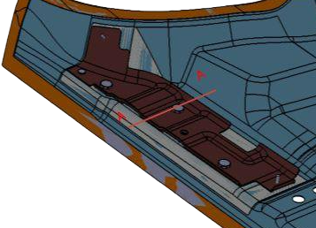
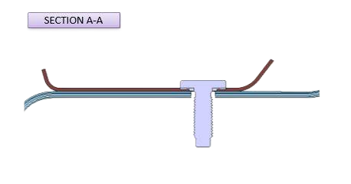
Fiber Glass (In white) covers completely the metal reinforcement to avoid any contact with Carbon Fiber
Section A-A (No Gap between Fiber glass and Metal Reinforcement

Slide 12
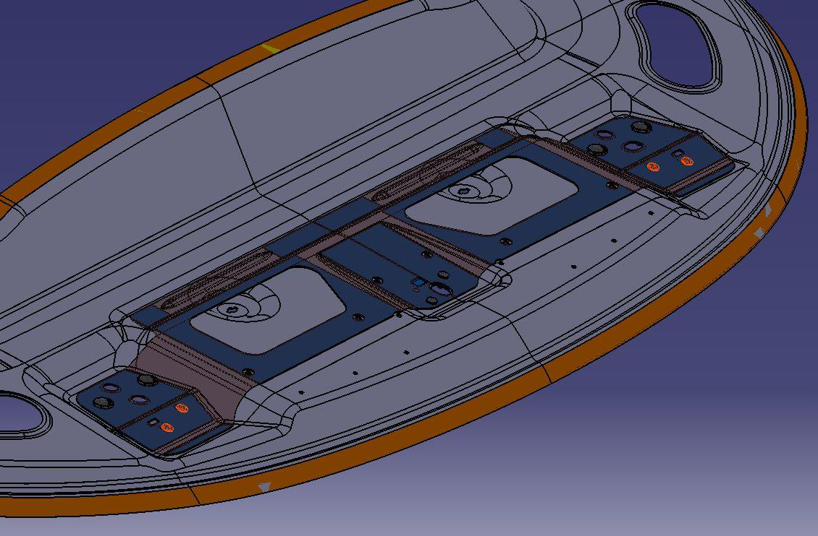
Corrosion Avoidance Measures for Fixings / Metal Reinforcements in CF Bonnets :-
Glue to cover all the area in contact with Carbon Fiber.

Slide 13
What are the advantages of CF bonnet :-
Advantages of Carbon Fiber Bonnets:
Reduced Weight:
Carbon fiber is significantly lighter than both steel and aluminum, leading to better fuel efficiency, faster acceleration, and improved handling.
Enhanced Strength:
While lighter, carbon fiber boasts a high strength-to-weight ratio, meaning it can be as strong or stronger than metal while weighing considerably less.
Corrosion Resistance:
Unlike metal, carbon fiber doesn't rust or corrode, ensuring longevity and a better appearance over time.
Dent Resistance:
Carbon fiber is more resistant to dents and minor impacts compared to metal, maintaining the hood's appearance and integrity.
Aerodynamic Benefits:
Carbon fiber can be molded into complex shapes and designs, allowing for better airflow and reduced drag, improving overall vehicle aerodynamics.
Aesthetic Appeal:
The sleek, woven pattern of carbon fiber can be visually appealing, and the material can be customized with various finishes.
Heat Management:
Carbon fiber can help manage heat better, especially when designed with vents or scoops, contributing to optimal engine bay temperatures.
Considerations:
Cost: Carbon fiber is generally more expensive than steel and aluminum.
Repair: Repairing carbon fiber can be more complex and costly than repairing metal.
Fire Hazard: While strong, carbon fiber is combustible and may burn more readily than metal in certain situations.
Recyclability: Recycling carbon fiber can be more challenging than recycling metal.

